Slide 1

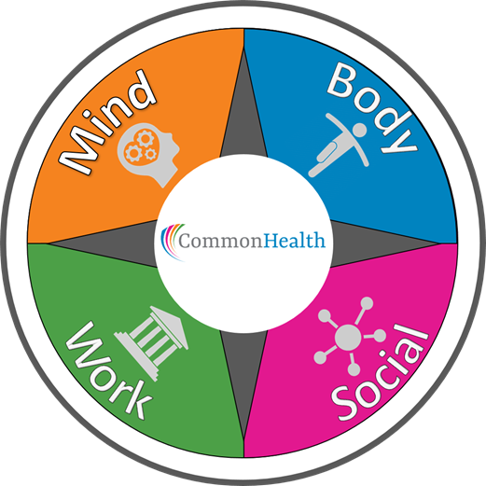

Virginia’s Employee Wellness Program
Department of Human Resource Management
  Office of Health Benefits
Notes:
Welcome to the CommonHealth Agency Coordinator Training and thank you for your interest in making the CommonHealth Wellness Program available to all of the employees of your agency. We appreciate your time and commitment.

Slide 2

Training Goals
  Provide the tools and resources needed to build and sustain an engaging and successful CommonHealth program at your agency
  Work together to make Virginia’s workforce the healthiest in the nation
Notes:
The goal of this training program is to give you tools and resources to help you to provide the CommonHealth Wellness benefit in a way that it is not only successful but also engaging for employees. For many years CommonHealth has been helping employees to live healthier . With your assistance, we can reach the Commonwealth’s goal for Virginia’s employees to be the healthiest in the nation.

Slide 3

CommonHealth’s Mission
Improve the health of state employees by:
  Integrating wellness into the workplace culture.
  Providing an environment that promotes and supports changes in health behavior.
  Building trustworthy partnerships between employer, employee, and our wellness partners.
Notes:
To achieve that goal we work together, with agency administrators and wellness partners to create an environment that promotes and supports employees’ efforts to make healthier lifestyle choices. By volunteering to coordinate the CommonHealth Program at your agency you are bringing us closer to realizing these goals. Thank you!
Now, let’s get down to some of the details that will help you succeed in your new role.

Slide 4
Wellness Benefits
Benefits to Individuals | Benefits to Agency
Improved health status | Improved employee health behavior
Reduced risk of chronic conditions | Reduced elevated health risk
Reduced stress | Reduced health care cost
Support to sustain healthier behavior | Improved productivity
Improved engagement and camaraderie | Decreased absenteeism/presenteeism
Low cost to participate | Improved recruitment and retention
Expert instruction | Build and sustain employee morale
Convenient | Increased engagement
Notes:
Wellness programs are more popular than ever. They started out as perks for large companies and used to be called corporate fitness programs. Wellness programs are now regularly part of most employee benefits package and if you think about it, worksites have become (sort of) chronic disease prevention centers.
Worksites are doing more than any other group to prevent, and even reverse, lifestyle diseases. Hospitals are great at treating disease and they are good at early detection of disease, but they don’t do much in the way of prevention. The total reach and impact of worksite wellness programs dwarfs all other efforts to improve the health of adults. And they do all this because employers enjoy the benefits that come from having a healthier workforce.
Evidence Shows the Benefits of Wellness! Think of the different benefits employers typically offer - retirement plans, healthcare, paid time off, or maternity leave. These are designed to help recruit and retain the best employees. Yet there are no published studies that show that these benefits have a measurable effect on the ability to recruit or retain workers. These things are actually very hard to study. We do them because we believe they are important, and we sense that they make a difference in our ability to attract good workers. But, there is no science to back this up.
Wellness programs, on the other hand, have been studied for decades. There are hundreds of rigorous scientific evaluations of the impact of wellness programs and we have an enormous amount of very solid data that show the benefits of having a wellness program. Wellness programs are good at helping people adopt and maintain healthy behaviors. This is perhaps the biggest benefit of having a wellness program. Healthy behaviors lead to lower health risks, and lower health risks lead to less chronic disease, and, with less chronic disease employees and employers have fewer health care costs.

Slide 5


Why Wellness?
COVID-19 presented seemingly insurmountable health, life, and business challenges.
Even before the pandemic:
We discovered that the very same chronic conditions put people at greater risk for complications with COVID-19.
6 out of 10 Americans were living with a chronic condition
4 out of 10 Americans were living with two or more chronic conditions
Notes:
COVID-19 presented seemingly insurmountable health, life, and
business challenges.
Even before the pandemic, 6 out of 10 Americans were living with a chronic condition, and 4 out of 10 with two or more. The world discovered these very same chronic conditions put people at extraordinary risk for complications with COVID-19.

Slide 6

Why CommonHealth Works
  Trustworthy partnerships
  Diverse team of health experts
  Targeted approaches: in-person, virtual, or hybrid
  Flexible to meet agency needs
  Regional support
  Tailored communications
  Varied techniques to reach employees
We are state employees too!
Notes:
Research shows us that chronic diseases are the manifestation of a short list of risk behaviors including; poor nutrition,
sedentary lifestyle, substance abuse (including tobacco and alcohol), stress and poor sleep.
CommonHealth addresses all of these risk behaviors directly through the four pillars our program; Move more, stress less, eat well and sleep better.
Additionally, each of our offerings are targeted, inclusive, and designed to meet employees where they are. This allows us to address the employee's needs within the flexible framework of our agency level delivery model.
By focusing on target areas that support prevention and effective condition management through healthy choices, CommonHealth is able to positively effect wellness outcomes.

Slide 7

Who Can Participate?
  All state employees at participating agencies, including wage, hourly, and part-time workers
  Covered dependents (over the age of 18)
  Retirees and their covered dependents
Notes:
One of the first questions you will be asked is… Who can participate?
Unlike some employee benefits, ALL active employees may participate in the CommonHealth program. This includes full time, part time, wage, hourly, adjunct, and seasonal employees. Anyone who receives a paycheck from the state may participate!
In addition, any employee’s dependent 18 years or older, and covered by one of the states health benefit plans may also participate. If fact, we encourage participation by family members– the added support from family members is very important as individuals make changes to live a healthier lifestyle.
Finally, we invite our state retirees and their covered dependents to join in CommonHealth activities and programs through their former agencies.

Slide 8
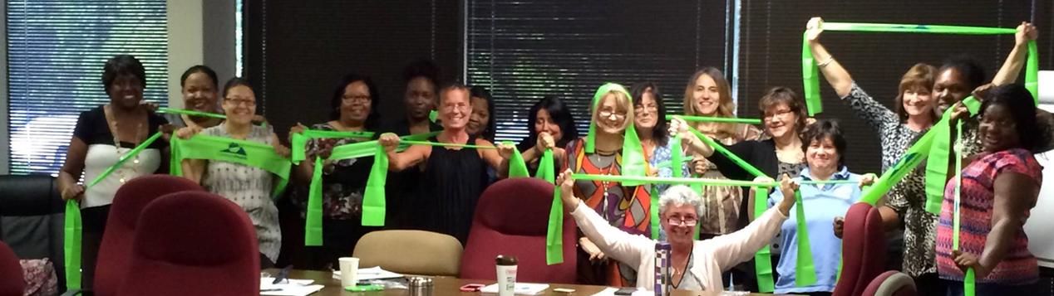
So...What Does CommonHealth Do?
  Create and deliver health education programs and periodic wellness challenges
  Empower employees to make/maintain positive lifestyle changes
  Share informative weekly messages (Wellnotes)
  Recognize employee achievements in health and wellness
  Raise awareness of available health and wellness benefits
  Serve as liaisons to connect agencies with similar interests
Notes:
So, what does CommonHealth do? Most importantly, we work with you to deliver health and wellness programs directly to your employees to help them make and maintain healthy lifestyle changes. Pre-covid that was usually done in person.
Once each week we communicate health information via email with our weekly Wellnote. These are short communications include helpful tips on exercise, diet, stress, sleep, and more.
We also strive to recognize employee achievement through our Wellness Champions program, which we'll talk more about later.
We work to increase awareness of the variety of wellness benefits available to employees who are enrolled in health plans. This includes ways to access mental health benefits through the EAP and ways to save money.
And last, but not least, we help agencies connect with other agencies that have similar interests.

Slide 9

Getting Started
Gather SUPPORT - key to success
  Agency Head
  HR Director
  Benefits Administrator(s)
  Managers and Supervisors
When we replaces I, Illness becomes Wellness
Notes:
Now, you may be wondering……how do I get started? Over the years we have found that the biggest key to having a successful and active CommonHealth Program is to have support from those at the top. So one of your first steps is to be sure that your agency administrators, human resources office,managers and supervisors are on board. If they understand that CommonHealth will benefit employees and, as a result, benefit the agency, they will be happy to lend their support.
As you ask for support, be sure that management understands that participation rarely interferes with the normal work day. Programs are usually offered at lunch time and during staff meetings and other events. And, CommonHealth has the ability to tailor programs to meet specific agency needs. With their support your efforts will go a long way. The best way for management to support CommonHealth is to let employees see them participating and encouraging others to participate.

Slide 10

Advisory Committees/Teams
Ask administrators and supervisors for assistance
  Cross-agency representation (Benefits, Safety, Medical, Training, Communications, IT, Front Line Workers, Employee Health Enthusiasts)
  Voluntary
  Regular meetings
  Outlined duties
  3-8 members
Notes:
In addition, many agency coordinators find it helpful to have an advisory committee to help share the load. Advisory committees are not required, but are helpful. They are particularly helpful in larger agencies or those with multiple sites (such as health districts, colleges and universities, VDOT residencies, etc.). Among other things, advisory committee members can assist with promoting programs, scheduling, and reserving space. When setting up a committee look for VOLUNTEERS who are enthusiastic and helpful. You also want a committee with diverse skills and to have representatives from various departments and/or locations. The size of the committee would depend on the size of the agency but in general should be between 3 members for smaller agencies and 8 members for larger agencies. If you have a very small agency an advisory committee may not be necessary.
Your regional Wellness Consultant can assist you in providing a “job description” for advisory committee members - this helps ensure that your committee members are truly helpful.

Slide 11

The Nuts and Bolts
  Schedule multiple health education campaigns with your Wellness Consultant each year
  Promote each campaign/activity - get the word out to all employees
  Coordinate wellness activities (e.g.: challenges)
  Distribute communication materials, including weekly Wellnotes, to all employees
  Attend meetings when scheduled
  Attend trainings when offered
Notes:
Next, we will cover the “nuts and bolts” of your responsibilities as an agency CommonHealth coordinator.
Our goal is to make providing CommonHealth straightforward and as simple as possible for you, the agency coordinators. As we review the responsibilities, please keep in mind that CommonHealth remains flexible to be able to meet each agency’s needs.
As the agency coordinator, your core responsibility is to schedule the CommonHealth educational programs and challenges with your Regional Wellness Consultant - ideally at least twice per year.
We will help you promote the programs with materials such as flyers, email messages and anything else you need to get the word out to increase participation.
In addition to planning programs, we ask you to distribute our email communications to all employees at your location. This includes our weekly Wellnotes and other special communications as they arise (not frequent).

Slide 12

Health Education Campaigns
and many more!
Notes:
As mentioned, one of your most significant contributions as an agency coordinator will be to work with the CommonHealth staff to schedule 2 health campaigns at your agency each year. These campaigns are created by the CommonHealth staff and new topics are introduced on a regular schedule. This slide shows just a few of our program topics.
In addition to CommonHealth’s campaign menu, your regional Wellness Consultant may be available to assist in providing information on topics of specific interest to your agency.

Slide 13
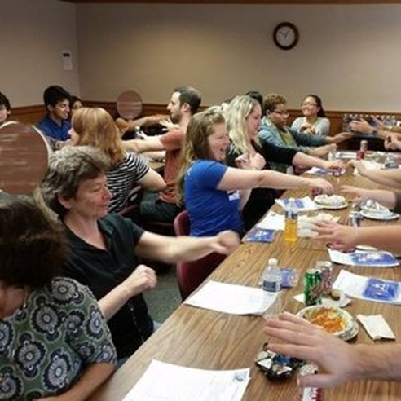
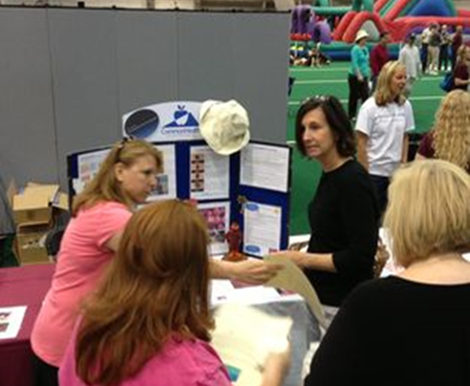
Strategies that Drive Participation
While every agency is unique, many locations have found success coordinating CommonHealth programs as part of:
  Staff meetings/picnics
  Employee appreciation/recognition events
  Orientation/training days
  Lunch and learn sessions
  State-wide conferences
Notes:
Staff meetings and special events are a perfect time to offer the CommonHealth program to your employees - It’s efficient and usually everyone can participate easily. Simply invite your Regional Wellness Consultant to present at your meeting and you determine how long that presentation will last. CommonHealth is flexible and wants to meet your agency's needs.

Slide 14
Options to Meet Your Needs
  Traditional Training - an onsite session that gives participants a deeper dive into educational materials facilitated by the Wellness Consultant (10-60+ minutes)
  Learning Station - an educational display located in a high traffic area where participants drop by to receive information from the Wellness Consultant in a more personal and relaxed format
  Virtual - online sessions can be hosted by the agency on a variety of platforms
Contact your Wellness Consultant to schedule!
Notes:
We understand that no two agencies are exactly alike, and one size doesn’t always fit all. For this reason, programs may be delivered in a variety of formats to meet your needs. Based on your what will work best for your agency, you can select the program delivery methods. Just schedule with your regional Wellness Consultant.
Traditional presentations can be delivered in 15 to 60 minutes or more. These may include powerpoint presentations, group activities and discussion.
Learning Stations are visual displays set in high traffic areas like lobbies, break rooms or cafeterias. Your regional Wellness Consultant will provide quick tips and information to interested employees as they stop byt the display. Learning stations work well during special events like employee appreciation luncheons, benefits Fairs and health screenings.
All CommonHealth programs are available virtually as well.
We hope with the variety of program formats, you will find it easy to schedule CommonHealth activities.

Slide 15
Communications
Wellnotes
Receive info on a variety of health topics delivered via email weekly.
Facebook
Search for CommonHealthVA and be sure to follow our page.
YouTube
Search for CommonHealthVA and be sure to subscribe to our channel.
Website
Get materials and resources at commonhealth.virginia.gov.
Notes:
We ask that you share our CommonHealth communications with the employees at your agency. These communications include our Wellnotes which are delivered via email each week, our Facebook and YouTube pages (simply search for CommonHealthVA and be sure to like, follow, subscribe, and share), and our website at commonhealth.virginia.gov.

Slide 16

Wellness Champions
Notes:
We mentioned our Wellness Champions program earlier as a way to help us recognize employee achievements in health and wellness. We want to celebrate those who live well and inspire others to do the same. Each year, we select the best of the best and name them as our “Wellness Champions.” While nominations can be made year round, the process is promoted during a specific time each year, and that time of year may vary. When that promotion period wraps up, the applications are reviewed and considered by the CommonHealth team. Up to five employees are selected each year and their stories are highlighted in CommonHealth publications. Individuals selected for the award receive a gift bag from CommonHealth and a certificate for serving as an inspirational role model.
Any state employee can submit a nomination of another state employee or a self-nomination. Spread the word and help us recognize the good!

Slide 17
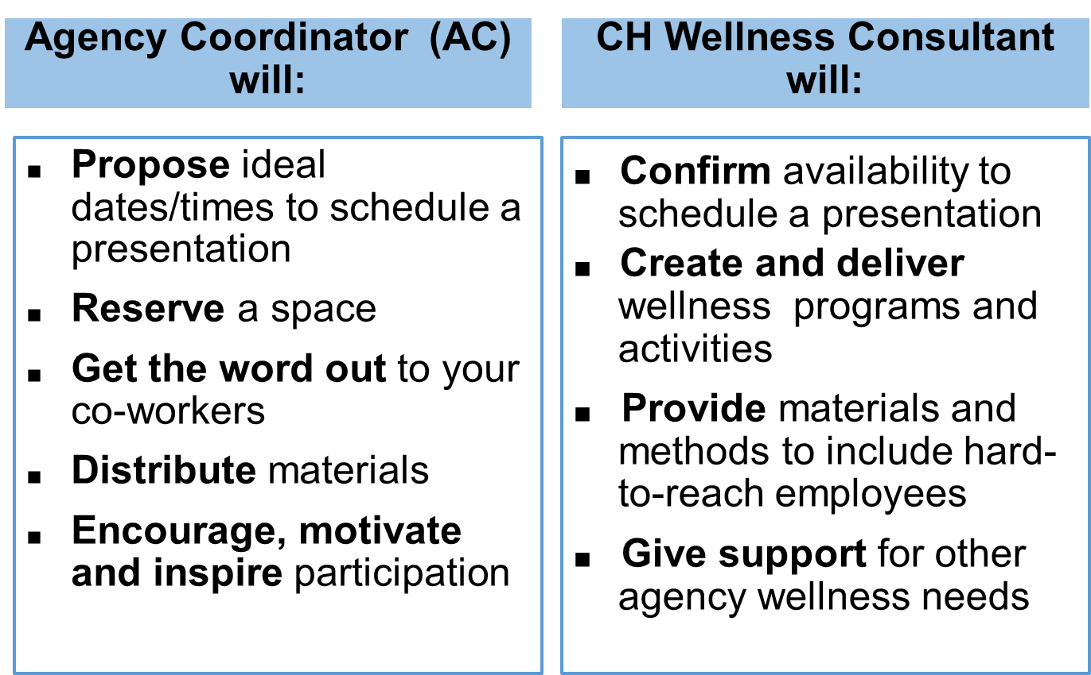
The Bottom Line
Notes:
Here’s the bottom line:
We ask our Agency Coordinators to propose dates and times to schedule a presentation, reserve a space, get the word out to their co-workers, distribute materials, and encourage participation.
Your regional Wellness Consultant will confirm their availability to schedule a presentation, create and deliver wellness programs and activities, provide materials and methods to include hard-to-read employees, and give support for other agency wellness needs.

Slide 18

What’s Next
Contact your Wellness Consultant. See next slide or commonhealth.virginia.gov for contact information. On the website:
  Click the About Us tab
  Click Wellness Consultants
  Wellness Consultants are listed by cities/counties served
Questions? Email wellness@dhrm.virginia.gov
Notes:
Are you excited? We hope so!
Your next step is to contact your Wellness Consultant. You'll see a list of our Wellness Consultants shortly, and you can also find them listed on our website. From the home page it will only take 2 clicks – About Us, then Wellness Consultants. Our Wellness Consultants are listed geographically by the cities/counties they serve.
Please contact your regional Wellness Consultant by email or phone and you will be on your way!
If you still aren't sure who your Wellness Consultant is, please send us an email at wellness@dhrm.virginia.gov or contact any of the Wellness Consultants for assistance.

Slide 19
Our Team of Wellness Consultants
Greater Richmond/Capitol Square: Jami Zanetta, jami.zanetta@dhrm.virginia.gov
Felix Johnson, felix.johnson@dhrm.virginia.gov
Petersburg/South Central: Craig Hicken, craig.hicken@dhrm.virginia.gov
Northern Virginia: Amy Moore, amy.moore@dhrm.virginia.gov
Williamsburg/Fredericksburg/East: Mary Louise Gerdes, marylouise.gerdes.virginia.gov
Tidewater/Eastern Shore: Cynthia Duncan, cynthia.duncan@dhrm.virginia.gov
Central Piedmont/Route 29 Corridor: Kelsey Jones, kelsey.jones@dhrm.virginia.gov
Northwest/Blue Ridge: Kristi Hall, kristina.hall@dhrm.virginia.gov
Roanoke/New River Valleys: Sue Perry, susan.perry@dhrm.virginia.gov
Southwest: Suzanne Meador, suzanne.meador@dhrm.virginia.gov
Notes:
Our team consists of 10 Wellness Consultants spread throughout the Commonwealth. We’re listed here by region. Find more information on which cities and counties are included in each region on our website, commonhealth.virginia.gov. Simply click About Us, then Wellness Consultants.

Slide 20
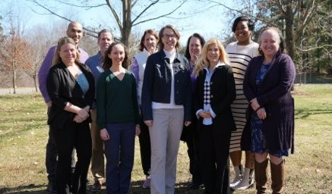
THANK YOU!
We look forward to working with you!
commonhealth.virginia.gov | wellness@dhrm.virginia.gov
Notes:
Thank you for your time and commitment to helping CommonHealth make Virginia’s employees the healthiest in the nation! We look forward to working with you! If you have any questions, please email us wellness@dhrm.virginia.gov. We wish you success and good health! Thank you, and enjoy the rest of your day!

